Slide 1
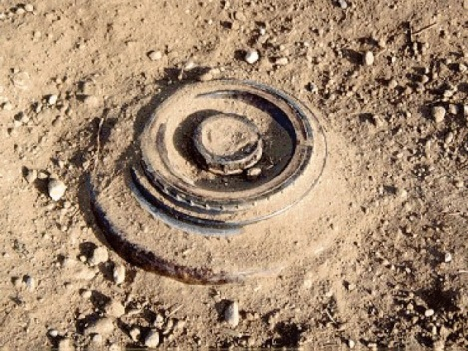
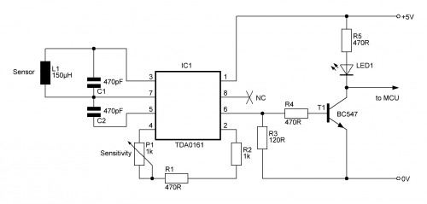
Design Features:
Low Ground Pressure
Minimum 80% Detection Rate
2 Hours Operational Time
Rechargeable
Low Cost
Portable and Backpackable
Problem:
The landmine crisis is globally alarming since there are presently 500 millions unexploded, buried mines in about 70 countries. Governments are looking into this situation seriously since landmines are claiming the limbs and lives of civilians everyday.
Company Info
International start-up LLC, offering an affordable solution to finding and marking potential mines in a unpassable search area. Founded in Denver, Colorado, this company offers unique engineering solutions to important humanitarian efforts. We offer our products to governments, local municipalities, and private entities that require such services.
Solution:
Cost-effective, area sweeping using mobile platform that can either be teleoperated from a cell phone or autonomously controlled to clear a defined area.
Detection Circuit
Made in the U.S.A

Slide 2
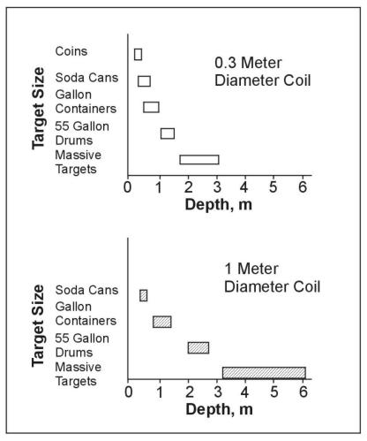



“… Life savior Product that has proven invaluable”
Hailemariam Desalegn
Ethiopia, Prime Minister
“ It is saving lives and saving limbs. Period.”
Gail J. McGovern
President of the American Red Cross
“The world owes a gratitude to the Anti-Personnel Mine Detection Robot for improving society …”
George Robertson
Former Secretary General of NATO
Anti-Personnel Mine Detection Robot
Detection Data
We have integrated a unique cell phone to cell phone Human-Robot Interface, and a modified sensor detection circuit to better identify the metal in selected land mines, including mines that are buried.

